Slide 1


Private overlay of enterprise social data and interactions in the public web context
Kundan Singh
Venkatesh Krishnaswamy
@CollaborateCom, Oct 2013

Slide 2
Enterprise social software
What are the problems?
How to solve them?
Poor adoption
Privacy threat
No persistence
Fragmentation
Integration of existing behavior
Separation of data and application
User in control of her data
What is Living Content?

Slide 3
In this talk…
What is the problem?
What are the use cases?
What is living content?
What does the project do?
What are the challenges?

Slide 4
What are the use cases?
Web Annotations
Private data in the context of public web pages
Virtual Presence
And messaging on any third-party web page
Enhance Page
By injecting presence, click-to-call or enterprise profile
Enhance Apps
Using user and data-centric application model

Slide 5
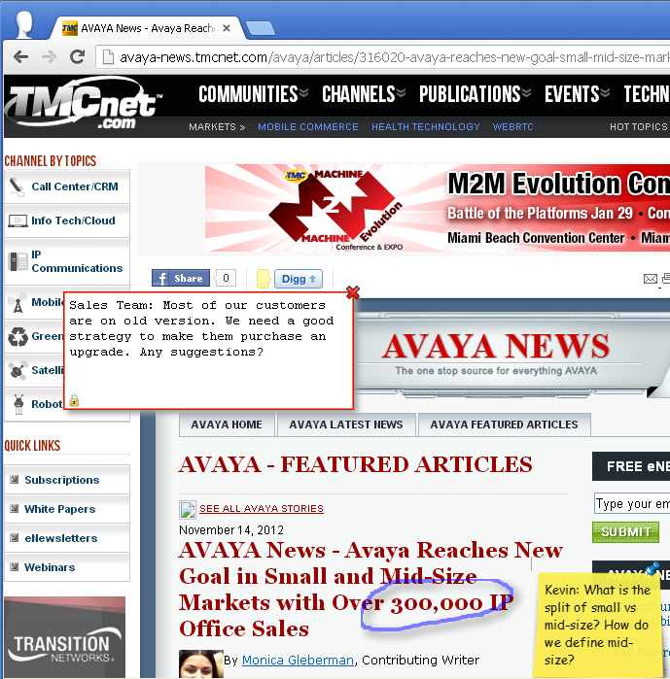
Use cases: web annotations private social data on public web – data remains private
Sales team on customer website
Sharing business knowledge
Job interviewers on the job advertisement web page
Overlay on public knowledge

Slide 6
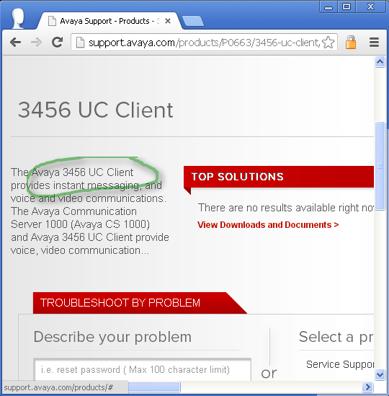
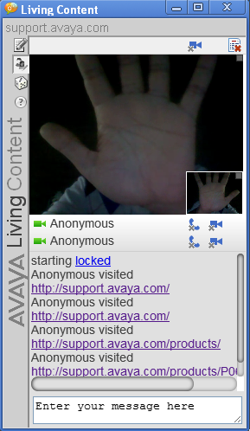
Use cases: virtual presence connected browsing with multimedia on any web page
Customer support and training
Zero-conf department meetings
Online job interview and candidates queue
Listen to user comments on any owned web page

Slide 7
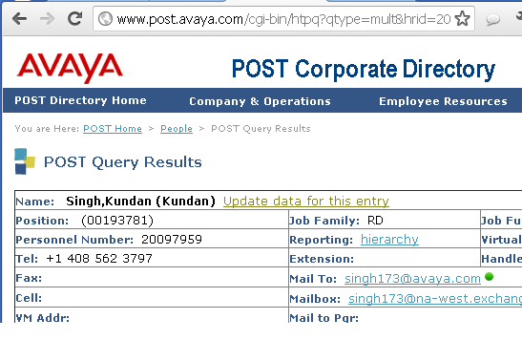
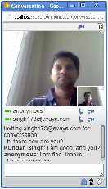
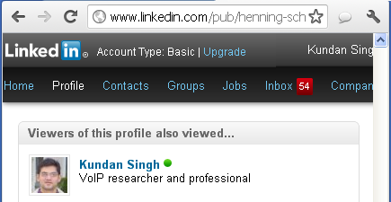
Use cases: enhance web pages without modifying files on those web servers
Annotate department webpage with lab webcam
Interaction in corporate or public social directory
Testers and developers coordinate on bug tracker page
Collate employee data and profile

Slide 8
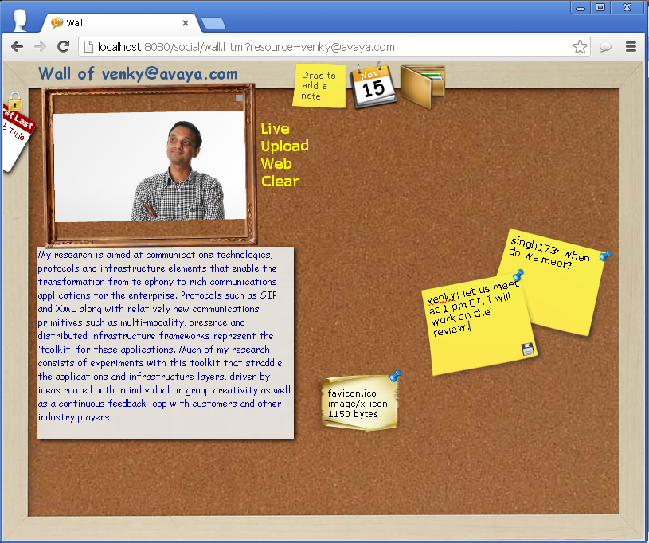
Use cases: enhance application or use cases such as collaborative editing, social wall, …
Enterprise user profile on social network sites
Co-edit technical documents
Personal wall for social connect
Context driven personal wall
Connect with existing cloud apps

Slide 9
What is living content?
A project…
A web page…
A browser extension…
A rich (HTML5) document
  can be sent, stored or put on a web site.
Allows editing and annotations by viewers
  edits and annotations are shared
Allows interaction among viewers
  interactions are stored
Allows branching the document view
  with merging and sharing
“Collaboration allows content”
or
“Content allows collaboration”
“Go to a place to collaborate”
or
“Collaborate where ever you are”

Slide 10
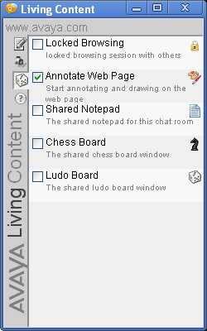
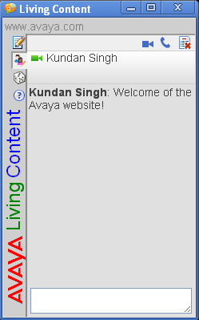
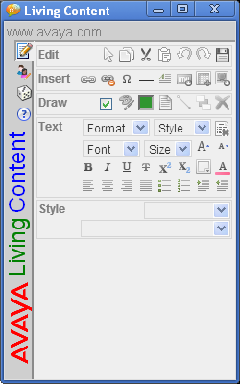
How does it work?
A browser extension
Chat room and data context per web page or website
Conversation window
1
avaya.com
youtube.com/xyz
linkedin.com
Browser
HTTP
Extension
Annotate
2
Bob
HTTP, websocket
Browser
Data
Browser
Extension
3
Extension
Annotate
Annotate
4
Resource server
Alice

Slide 11
Demonstration
What just happened in the demo video?
Browser extension, resource server, WebSocket
Virtual presence, real-time multimedia interaction (WebRTC), text chat and file sharing
Web annotations, web context, co-editing
Enhance third-party web sites, presence, click-to-call
Personal wall, video presence and sharing

Slide 12
What are the important concepts?
Separation of data from application
  Resource application model
  App-logic runs in the browser
  Data storage is separately maintained and controlled
Generic browser extension to link context with data
  Pluggable app framework
  Individual app-logic launched on demand
  Annotate, interact, presence, notepad, co-browse, …
Application mash-ups at the data level
  Data produced and consumed by independent unrelated apps
  Ask permission from the user instead of the app
  Resource connectors to legacy apps where needed

Slide 13
What are the challenges?
Keeping app logic in the browser
User interface dynamic layout
Security, privacy, access control and groups
Enterprise policies to social data
Bootstrapping social profile
Context from content and visitor
Secondary web of annotations and interactions
Interoperating with existing systems
…
Many more questions are answered in the detailed paper
Contact: singh173@avaya.com

Slide 14
What is the take-home message?
Enterprise social software
Solution
Poor adoption
Privacy threat
No persistence
Fragmentation
Integration of existing behavior
Separation of data and application
User in control of her data
Thanks to HTML5 (WebSocket, WebRTC, etc.)
seemingly complex communication scenarios and app-logic can run entirely in the browser

